Slide 1

Milestone 4: Testing and Delivery
WEEKS 7–8
MEDTRACK
Project: MedTrack – Hospital Operations & Patient Analytics Dashboard
Milestone Focus: Testing and validation of the developed dashboards; KPI calculation verification; Healthcare metric validation; Dashboard interaction testing; Patient flow analytics validation; Final documentation and project delivery.
Module 7
Testing & Validation
Module 8
Documentation & Project Delivery

Slide 2

Module 7: Testing & Validation
Testing Objectives
Accurate KPIs
Reliable Visualisations
The objective of Module 7 was to ensure that the MedTrack dashboards were accurate, functional and reliable.
Verified against source data
Charts and graphs validated
Testing Areas
Validate KPI calculations
Verify healthcare metrics
Test dashboard interactions
Validate patient flow analytics
Check dashboard visualisations
Verify filters and navigation
Identify and resolve dashboard issues
Functional Dashboards
All interactions confirmed
Expected Outcome: Accurate KPIs + Reliable Visualisations + Functional Dashboards

Slide 3
KPI Validation
Major hospital KPIs were validated against the underlying patient dataset. KPI accuracy target of above 95% was achieved.
KPI Metric
Validated Value
Status
Total Admissions
1,00,000
✅ Passed
Average Length of Stay
5.36 Days
✅ Passed
Readmission Rate
7.48%
✅ Passed
Average Treatment Cost
₹4,893.89
✅ Passed
Bed Utilisation Rate
81.54%
✅ Passed
Occupancy Rate
81.54%
✅ Passed
Number of Doctors
500
✅ Passed
Validation Result: KPI calculations successfully validated; Values displayed correctly on dashboards; KPI accuracy target of above 95% achieved.

Slide 4

Dashboard Testing
Four Dashboards Tested — All four dashboards were successfully tested.
1
2
Hospital Overview
Patient Flow
Hospital-level KPIs
Monthly admissions
Department contribution
Insurance and severity distribution
Admission trends
Patient outcomes
Wait time analysis
Department-wise activity
3
4
Department Analytics
Resource Utilisation
Department performance
Readmission analysis
Efficiency comparison
Department summary
Bed utilisation
Occupancy
Resource consumption
Capacity utilisation

Slide 5

Interaction & Functional Testing
Dashboard Interaction Testing Areas
Validation Results
Interactive filters
Dashboard navigation
Worksheet interactions
Chart selection
Tooltips
Cross-dashboard consistency
Visual responsiveness
Test Item
Result
Filters
✅ Passed
Navigation
✅ Passed
Charts
✅ Passed
Tooltips
✅ Passed
Final Result: No major dashboard issues were identified.
Dashboard Loading
✅ Passed
Visualisations
✅ Passed

Slide 6
Patient Flow Validation & QA
Patient Flow Analytics Tested
QA Checklist
Monthly patient admission trends
Patient outcome distribution
Average waiting time
Average length of stay
Wait Time vs Length of Stay
Department-wise weekday activity
Dataset loading
Data types
KPI calculations
Healthcare metrics
Visualisations
Filters
Dashboard interactions
Result: Patient flow analytics were validated successfully.
Formatting and layout

Slide 7
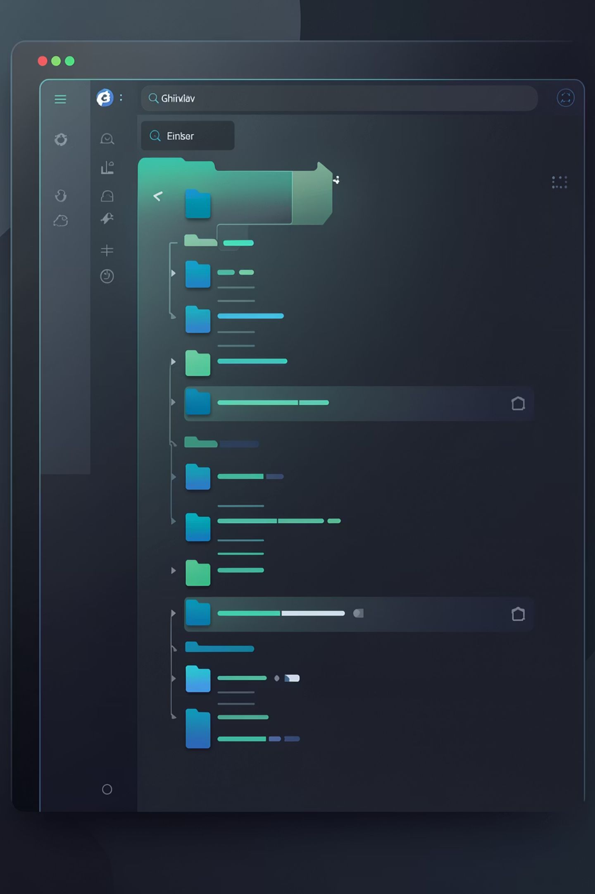
Module 8: Documentation & Project Delivery
Documentation Prepared
Project Structure
Dataset source and description
KPI definitions
Dashboard guide
Healthcare operations methodology
Data preparation methodology
Dashboard descriptions
Key insights
Testing and validation results
Conclusion and future scope
MedTrack-Hospital-Analytics/
├── scripts/
├── data/
├── dashboard/
├── docs/
└── README.md
Final Deliverables
Final Documentation
QA Checklist
Dashboard Testing Report
Tableau Workbook
GitHub Repository – final delivery step

Slide 8

Final Outcome & Delivery
MILESTONE 4 COMPLETION
Module 7 – Testing & Validation
Module 8 – Documentation & Delivery
KPI calculations validated
Final documentation prepared
Healthcare metrics verified
KPI definitions documented
Dashboard interactions tested
Dashboard guide prepared
Patient flow analytics validated
Project structure defined
QA Checklist prepared
Tableau workbook completed
Dashboard Testing Report prepared
GitHub Repository – final delivery step
Final Outcome: MedTrack is a tested, validated and documented Tableau-based hospital analytics solution ready for final project delivery.
Thank You – Questions & Discussion

